Slide 1
Epipolar Geometry class 11
Multiple View Geometry
Comp 290-089
Marc Pollefeys

Slide 2
Content
Background: Projective geometry (2D, 3D), Parameter estimation, Algorithm evaluation.
Single View: Camera model, Calibration, Single View Geometry.
Two Views: Epipolar Geometry, 3D reconstruction, Computing F, Computing structure, Plane and homographies.
Three Views: Trifocal Tensor, Computing T.
More Views: N-Linearities, Multiple view reconstruction, Bundle adjustment, auto-calibration, Dynamic SfM, Cheirality, Duality

Slide 3
Multiple View Geometry course schedule
(subject to change)
Jan. 7, 9 | Intro & motivation | Projective 2D Geometry
Jan. 14, 16 | (no class) | Projective 2D Geometry
Jan. 21, 23 | Projective 3D Geometry | (no class)
Jan. 28, 30 | Parameter Estimation | Parameter Estimation
Feb. 4, 6 | Algorithm Evaluation | Camera Models
Feb. 11, 13 | Camera Calibration | Single View Geometry
Feb. 18, 20 | Epipolar Geometry | 3D reconstruction
Feb. 25, 27 | Fund. Matrix Comp. | Structure Comp.
Mar. 4, 6 | Planes & Homographies | Trifocal Tensor
Mar. 18, 20 | Three View Reconstruction | Multiple View Geometry
Mar. 25, 27 | MultipleView Reconstruction | Bundle adjustment
Apr. 1, 3 | Auto-Calibration | Papers
Apr. 8, 10 | Dynamic SfM | Papers
Apr. 15, 17 | Cheirality | Papers
Apr. 22, 24 | Duality | Project Demos

Slide 4


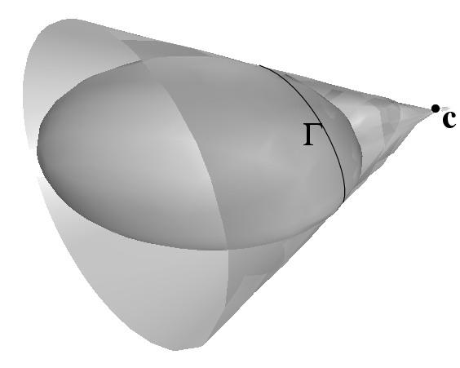


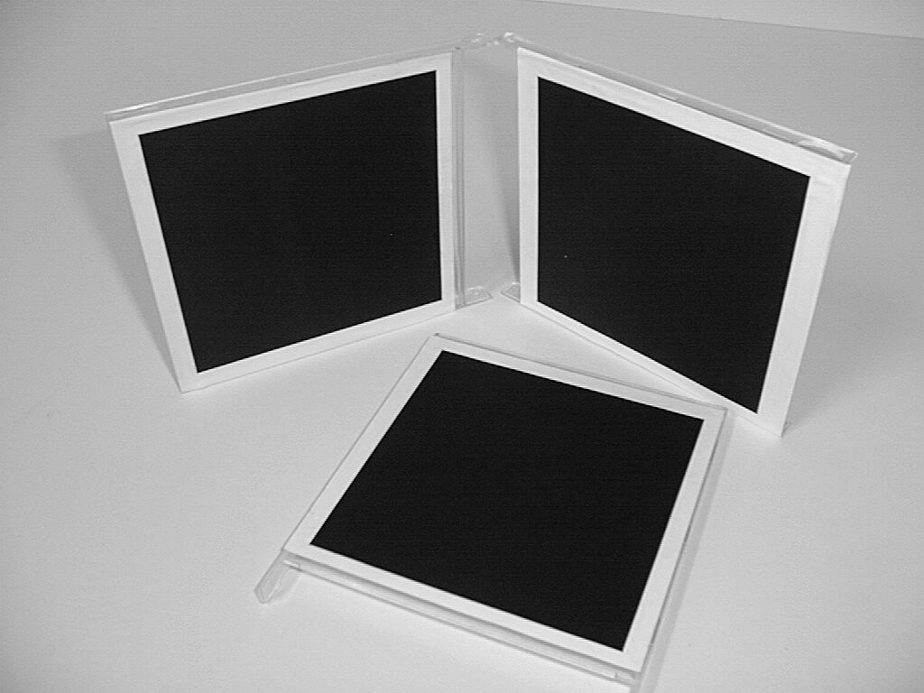
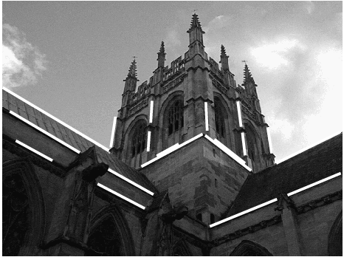
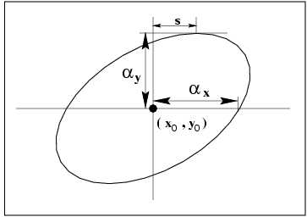
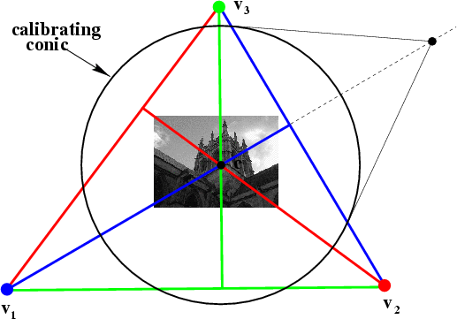
More Single-View Geometry
Projective cameras and
planes, lines, conics and quadrics.
Camera calibration and vanishing points, calibrating conic and the IAC

Slide 5

Two-view geometry
Epipolar geometry
3D reconstruction
F-matrix comp.
Structure comp.

Slide 6
Three questions:
Correspondence geometry: Given an image point x in the first view, how does this constrain the position of the corresponding point x’ in the second image?
(ii) Camera geometry (motion): Given a set of corresponding image points {x_{i} ↔x’_{i}}, i=1,…,n, what are the cameras P and P’ for the two views?
(iii) Scene geometry (structure): Given corresponding image points x_{i} ↔x’_{i} and cameras P, P’, what is the position of (their pre-image) X in space?

Slide 7
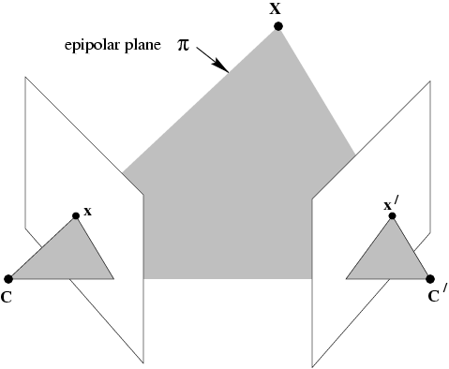
The epipolar geometry
C,C’,x,x’ and X are coplanar

Slide 8
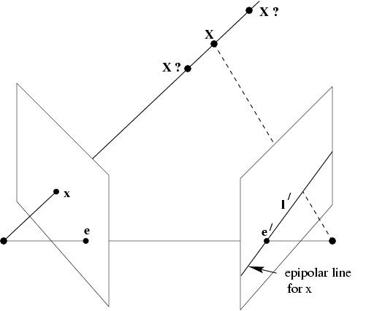
The epipolar geometry
What if only C,C’,x are known?

Slide 9
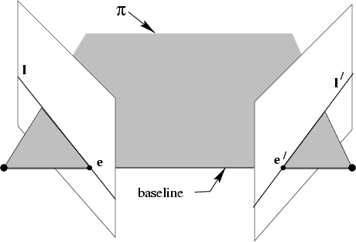
The epipolar geometry
All points on π project on l and l’

Slide 10
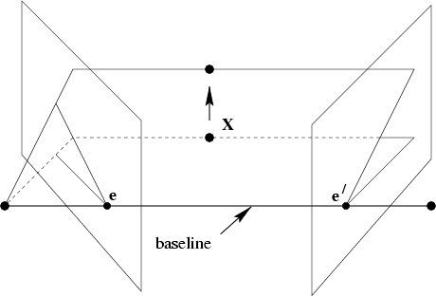
The epipolar geometry
Family of planes π and lines l and l’
Intersection in e and e’

Slide 11
The epipolar geometry
epipoles e,e’
= intersection of baseline with image plane
= projection of projection center in other image
= vanishing point of camera motion direction
an epipolar plane = plane containing baseline (1-D family)
an epipolar line = intersection of epipolar plane with image
(always come in corresponding pairs)

Slide 12
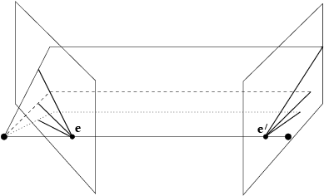
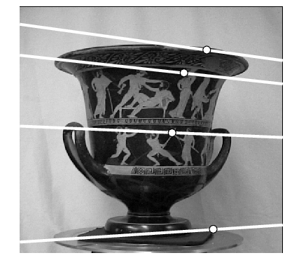
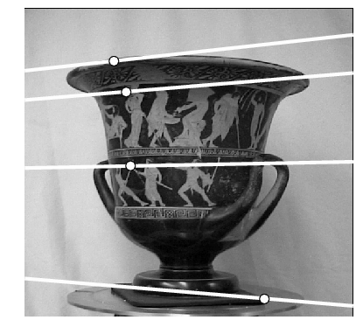
Example: converging cameras

Slide 13
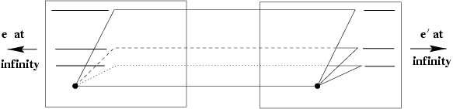
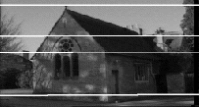
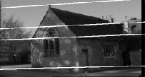
Example: motion parallel with image plane

Slide 14
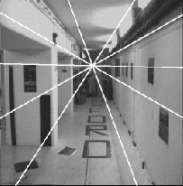
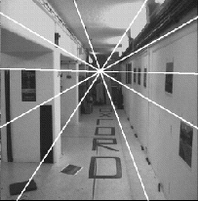
Example: forward motion
e’
e

Slide 15

The fundamental matrix F
algebraic representation of epipolar geometry
we will see that mapping is (singular) correlation (i.e. projective mapping from points to lines) represented by the fundamental matrix F

Slide 16
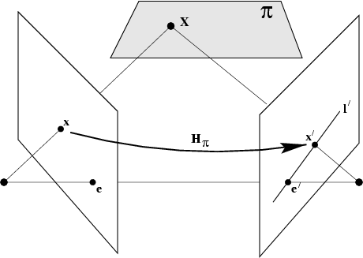
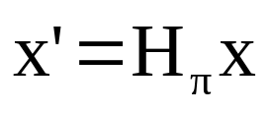

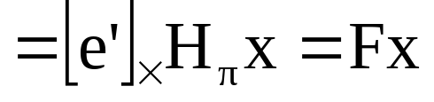
The fundamental matrix F
geometric derivation
mapping from 2-D to 1-D family (rank 2)

Slide 17
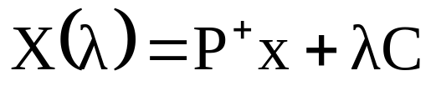
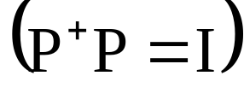
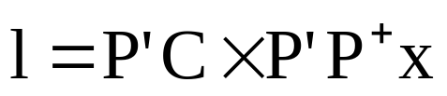


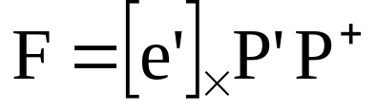
The fundamental matrix F
algebraic derivation
(note: doesn’t work for C=C’ ⇒ F=0)

Slide 18
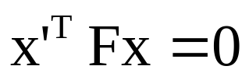

The fundamental matrix F
correspondence condition
The fundamental matrix satisfies the condition that for any pair of corresponding points x↔x’ in the two images

Slide 19
The fundamental matrix F
F is the unique 3x3 rank 2 matrix that satisfies x’^{T}Fx=0 for all x↔x’
Transpose: if F is fundamental matrix for (P,P’), then F^{T} is fundamental matrix for (P’,P)
Epipolar lines: l’=Fx & l=F^{T}x’
Epipoles: on all epipolar lines, thus e’^{T}Fx=0, ∀x ⇒e’^{T}F=0, similarly Fe=0
F has 7 d.o.f. , i.e. 3x3-1(homogeneous)-1(rank2)
F is a correlation, projective mapping from a point x to a line l’=Fx (not a proper correlation, i.e. not invertible)

Slide 20







The epipolar line geometry
l,l’ epipolar lines, k line not through e
⇒ l’=F[k]_{x}l and symmetrically l=F^{T}[k’]_{x}l’
(pick k=e, since e^{T}e≠0)

Slide 21
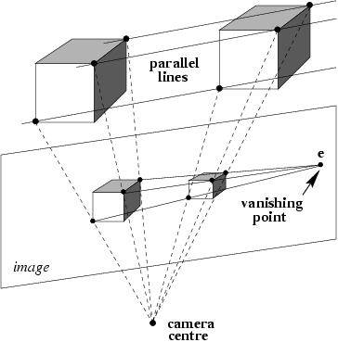
Fundamental matrix for pure translation

Slide 22
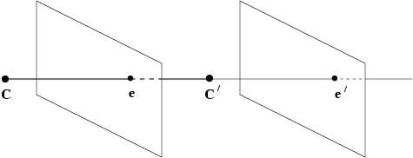
Fundamental matrix for pure translation

Slide 23


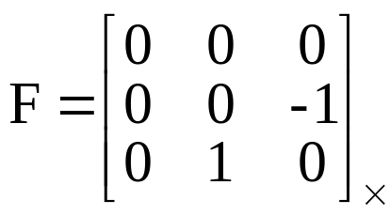

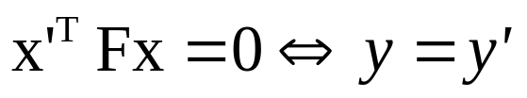


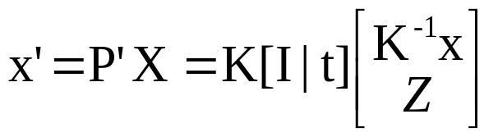

Fundamental matrix for pure translation
example:
motion starts at x and moves towards e, faster depending on Z
pure translation: F only 2 d.o.f., x^{T}[e]_{x}x=0 ⇒ auto-epipolar

Slide 24
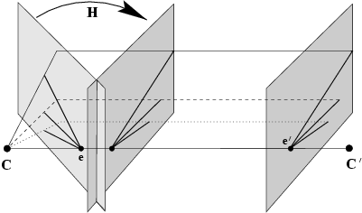



General motion

Slide 25
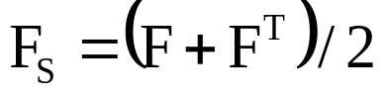


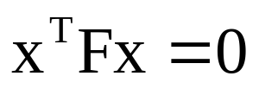


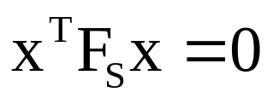
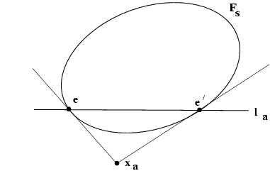
Geometric representation of F
F_{s}: Steiner conic, 5 d.o.f.
F_{a}=[x_{a}]_{x}: pole of line ee’ w.r.t. F_{s}, 2 d.o.f.

Slide 26
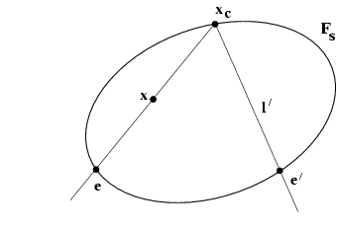
Geometric representation of F

Slide 27
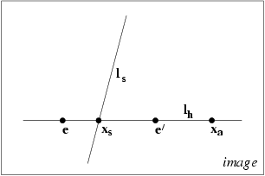
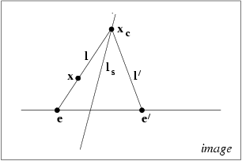
Pure planar motion
Steiner conic F_{s} is degenerate (two lines)

Slide 28
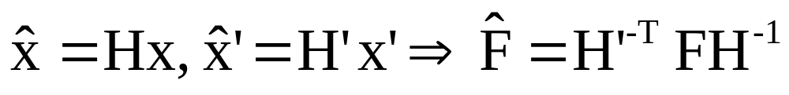
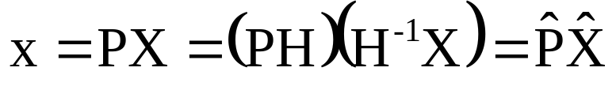
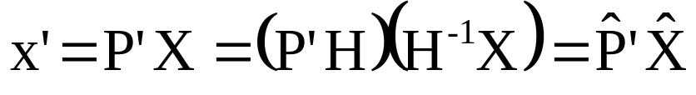
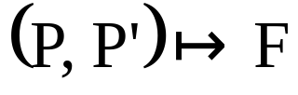
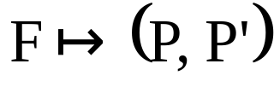
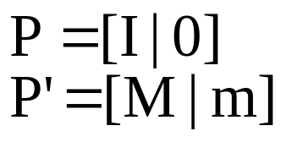
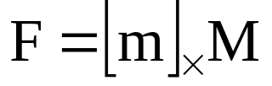
Projective transformation and invariance
Derivation based purely on projective concepts
F invariant to transformations of projective 3-space
unique
not unique
canonical form

Slide 29


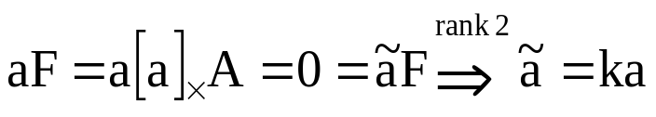
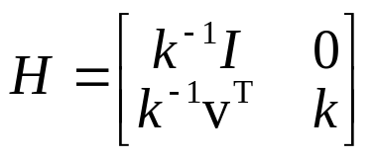
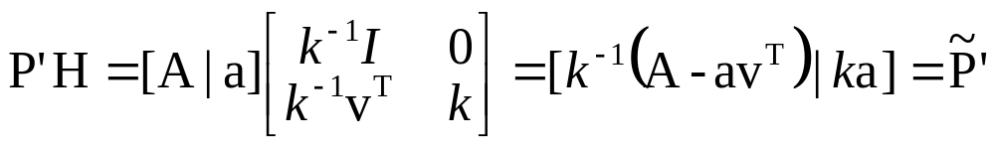
Projective ambiguity of cameras given F
previous slide: at least projective ambiguity
this slide: not more!
~ ~
Show that if F is same for (P,P’) and (P,P’),
there exists a projective transformation H so that
P=HP and P’=HP’
~
~
lemma:
(22-15=7, ok)

Slide 30


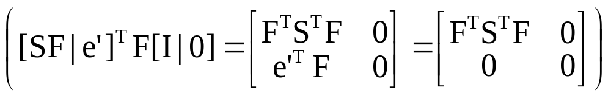


Canonical cameras given F
F matrix corresponds to P,P’ iff P’^{T}FP is skew-symmetric
F matrix, S skew-symmetric matrix
(fund.matrix=F)
Possible choice:
Canonical representation:

Slide 31





The essential matrix
~fundamental matrix for calibrated cameras (remove K)
5 d.o.f. (3 for R; 2 for t up to scale)
E is essential matrix if and only if
two singularvalues are equal (and third=0)

Slide 32
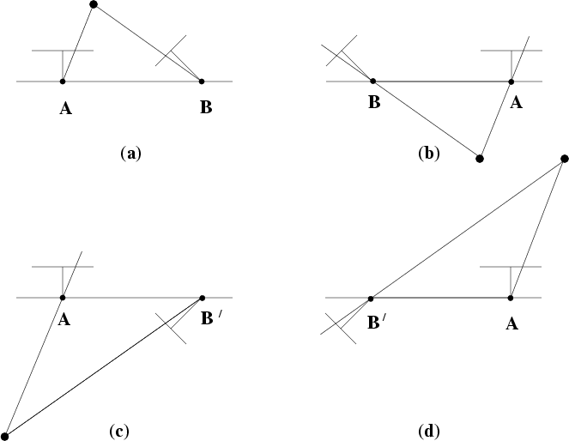
Four possible reconstructions from E
(only one solution where points is in front of both cameras)

Slide 33

Next class: 3D reconstruction

